Slide 1
Sustainable Peatlands
Chapter
16
Learning outcomes: 2.3

Slide 2
At the end of this chapter, you will be able to:
16.1 Describe the two different types of bog in Ireland.
16.2 Identify the role of Bord na Móna.
16.3 Describe the impacts of peat exploitation.
16.4 Discuss sustainable peatlands.

Slide 3
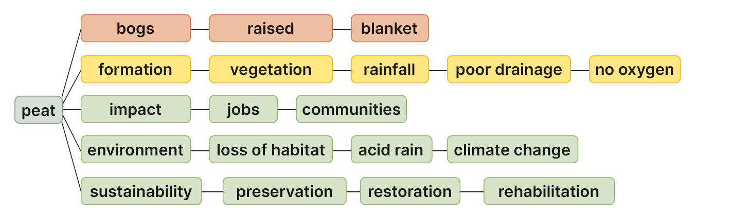
Keyword connections

Slide 4
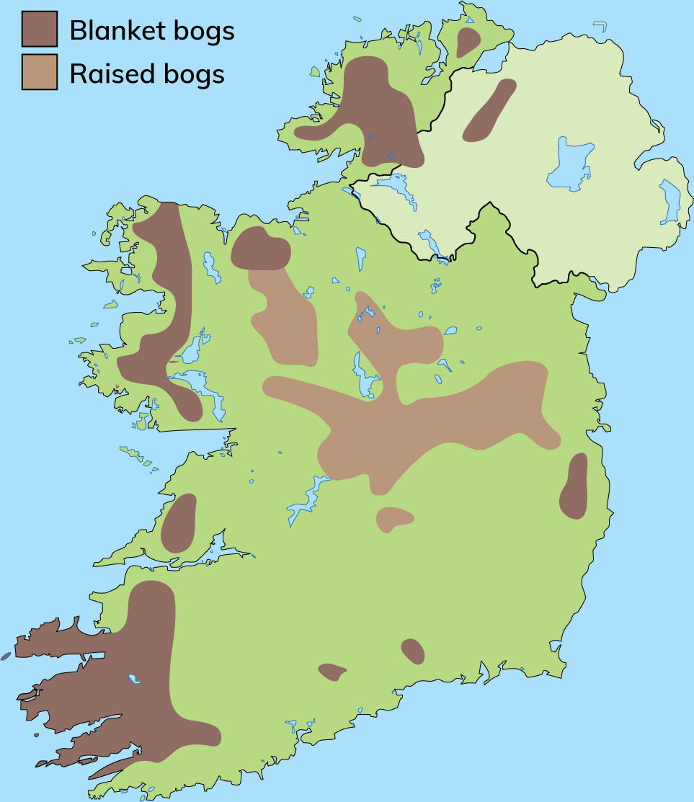
16.1 Describe the two different types of bog in Ireland.
Peat is a non-renewable resource harvested from bogs.
There are two types of bogs:
1. Raised bogs
On flat or gently sloping lowlands
In the Midlands
Form in shallow depressions
Depth of 8–12 m
2. Blanket bogs
On mountain slopes
Areas of heavy rainfall
West of Ireland
Average peat depth of 3 m

Slide 5
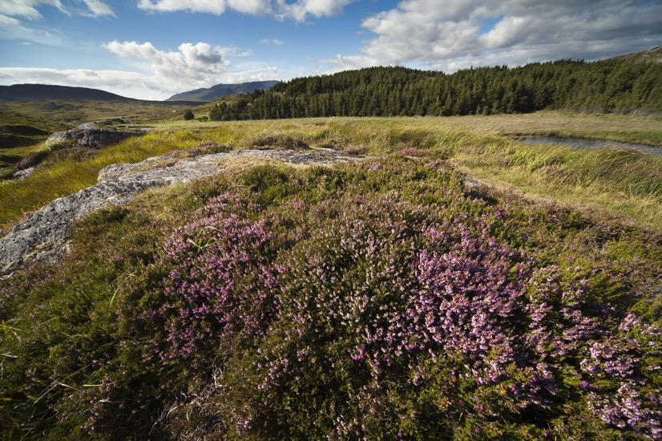
16.1 Describe the two different types of bog in Ireland.
The Formation of Peat
Peat is composed of partially decayed plant litter. Four conditions are needed for peat to form:
1. Growth of vegetation
2. High levels of rainfall
3. Poor drainage so that soils become waterlogged
4. Low or no oxygen in the waterlogged soil

Slide 6
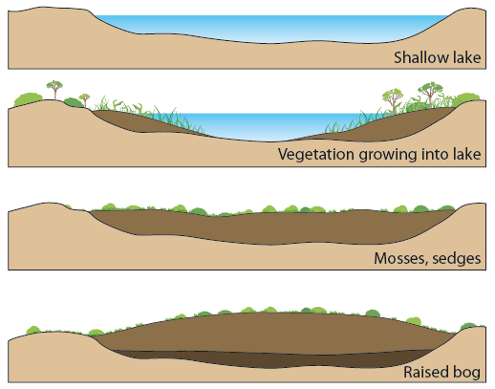
16.1 Describe the two different types of bog in Ireland.
The Formation of Peat
Ireland’s bogs formed after the last ice age.
As the ice retreated, it deposited large amounts of sediment in the form of undulating hills, (e.g. drumlins).
Between the hills were many hollows with poor drainage.
As plant litter died, it did not decay because of the absence of oxygen in the waterlogged soil.
Over time, layers of plant litter built up to form Ireland’s boglands.

Slide 7
16.1 Describe the two different types of bog in Ireland.
Go to Section 16.1 on page 88 of your Skills Book.

Slide 8
16.2 Identify the role of Bord na Móna.
In 1934 the Turf Development Board was set up to exploit peat in Ireland.
During the Second World War, turf became very important, as coal was in short supply.
In 1946, the Turf Development Board became Bord na Móna.
The focus of its work was harvesting peat for fuel.
Over time, the company diversified and began producing peat moss.
More recently, Bord na Móna has become a climate solutions company, and is investing in renewable energy sources.
The company is working towards preserving bogs for future generations to enjoy.
In 2020, Bord na Móna stopped harvesting peat for electricity generation.

Slide 9
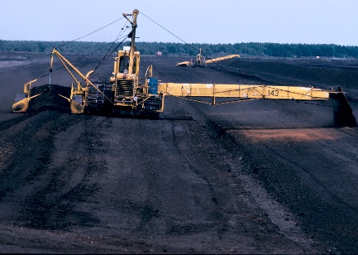
16.2 Identify the role of Bord na Móna.
Extracting peat
The harvesting of turf is an extractive industry.
This means that the resource is removed from the Earth.
Traditionally, people harvested turf by hand, using a type of spade called a sleán. The sods of turf were then stacked and left to dry.
This traditional method of harvesting turf was very slow.
The Irish government created Bord na Móna to exploit peat in a commercial way and develop the peat industry.
Bord na Móna developed machinery that would harvest peat in large quantities for use in electricity generation.

Slide 10
16.2 Identify the role of Bord na Móna.
Go to Section 16.2 on page 88 of your Skills Book.

Slide 11
16.3 Describe the impacts of peat exploitation.
Social impacts
Economic impacts
Environmental impacts
Exploiting the bogs created employment, which raised workers’ standard of living.
Creating jobs reduced rural emigration, as people could find work locally. Bord na Móna built housing for its workers. Close-knit communities grew up around peatlands.
Peat extraction became an important feature of rural life in the midlands of Ireland.
Extracting peat created jobs. Workers had steady work and earned good wages. In some cases, generations of the same families worked for Bord na Móna.
Burning peat reduced our dependence on imported fossil fuels and saved the country money.
Bord na Móna exported peat products to other countries. This increased the income earned by the country.
The habitat of bogs was destroyed when the raised bogs were drained and then harvested. The cut-away bogs had no plant or animal life.
Burning peat added carbon dioxide (CO₂) to the atmosphere. In addition to this, once a bog was cut away, it could no longer absorb CO₂.
The burning of peat also contributed to the formation of acid rain.

Slide 12

16.1, 16.2 and 16.3
1. Name three differences between a raised bog and a blanket bog.
2. How does peat form?
3. What is sphagnum moss?
4. Name two economic and two social impacts of peat exploitation in Ireland.
5. Why has Bord na Móna stopped burning peat?

Slide 13
16.1, 16.2 and 16.3
Higher-order questions 1
1. Why do you think most blanket bogs are located along the west coast of Ireland?
2. What connections can you make between what you learned about glaciation and the what you learned about the formation of peat?
3. What are the implications for peatland workers and their communities of the move to stop burning peat? What steps can be taken to reduce the effects of Bord na Móna’s decision?

Slide 14
16.3 Describe the impacts of peat exploitation.
Go to Section 16.3 on page 89 of your Skills Book.

Slide 15
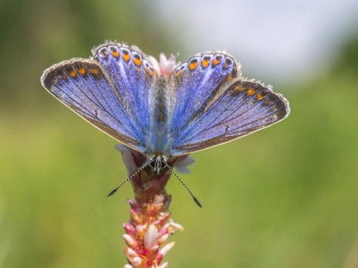
16.4 Discuss sustainable peatlands.
Bogs are important habitats for plants and animals. They are also important in combatting climate change. By using peatland sustainably, we can preserve plant and animal habitats for future generations and help reduce climate change.
Protecting bogs
Ireland has the greatest extent of active bogland in Europe. Bogs act as a carbon store.
They are home to many plants, such as sphagnum moss, lichen, sundew and bog-rosemary.
Bogs are also rich in animal life, including hares, grouse, frogs, dragonflies and curlew.
Cutting bogs destroys the habitat of this flora and fauna, and releases CO₂ into the air. Of the original 1.2 million hectares of bog in Ireland, only 23 per cent survives. Only 10 per cent of raised bog remains.

Slide 16
16.4 Discuss sustainable peatlands.
Bogs are important habitats for plants and animals. They are also important in combatting climate change. By using peatland sustainably, we can preserve plant and animal habitats for future generations and help reduce climate change.
Restoring and rehabilitating bogs
Bord na Móna no longer harvests peat for electricity generation.
It aims to contribute to making Ireland carbon neutral by 2050.
The company manages 80,000 hectares of bogland.
This could store up to 100 million tons of CO₂.
To help achieve this goal, Bord na Móna is:
Restoring bogs: Bogs are restored by re-wetting them. Drainage ditches are sealed and water is returned to the bog so that sphagnum moss can grow again. Over 7,000 hectares of bog have already been restored.
Rehabilitating bogs: Where a bog cannot be returned to a bog-forming state, Bord na Móna aims to use the bog to create new habitats. Over 20,000 hectares of bog have been rehabilitated.

Slide 17
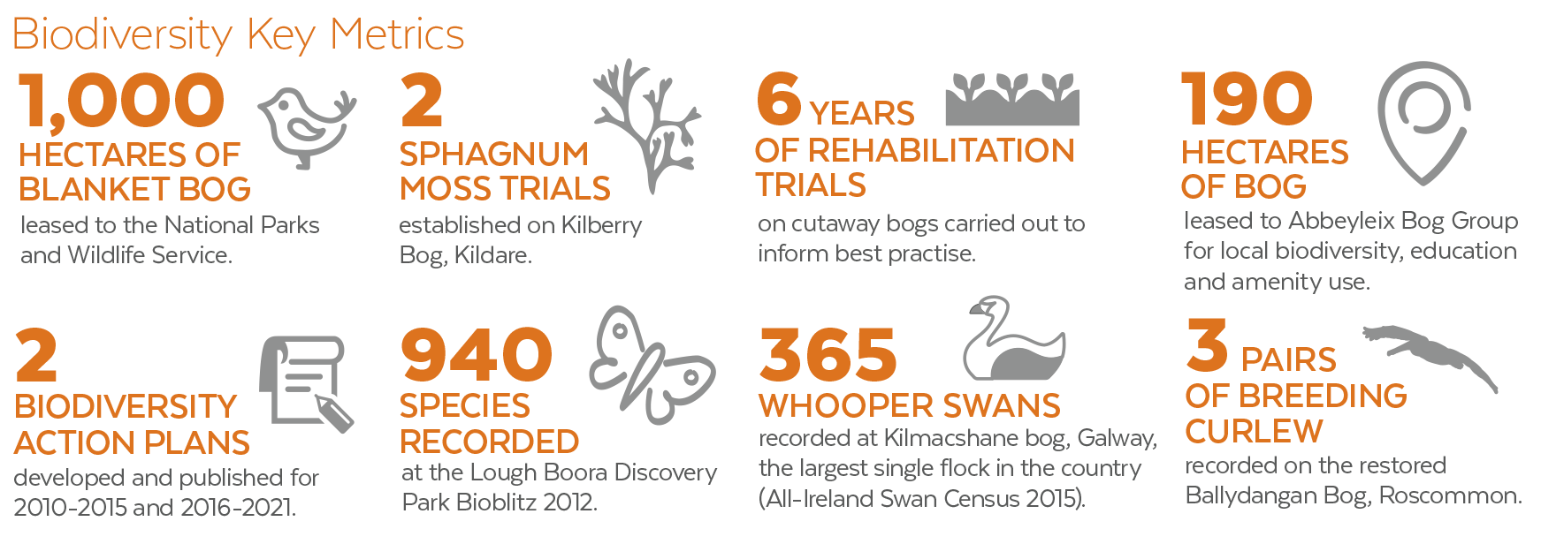
16.4 Discuss sustainable peatlands.
Bord na Móna is working to restore biodiversity to its cutaway bogs.

Slide 18
16.4 Discuss sustainable peatlands.
Go to Section 16.4 on page 89 of your Skills Book.

Slide 19
Assess your progress
Go to page 90 of your Skills Book and assess your progress.
16.1 Describe the two different types of bog in Ireland.
16.2 Identify the role of Bord na Móna.
16.3 Describe the impacts of peat exploitation.
16.4 Discuss sustainable peatlands.
Identify any gaps in your learning. Use the Rapid Revision on page 201 of your Textbook to jog your memory.

